Slide 1
Tools of the Trade
Janet Zappe RN, MS, CDE
Clinical Program Manager
Ohio State University Wexner Medical Center
Division of Endocrinology, Diabetes & Metabolism

Slide 2
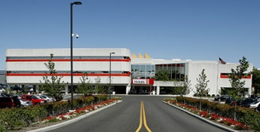
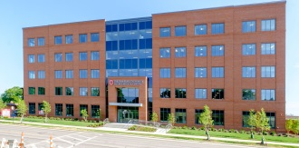
Scarlet & Gray Way to Diabetes Self-Management
CarePoint East
Program Background
Education program ADA accredited since 2002
Classes and 1:1 appointments
Staying The Course follow up class
New pump starts >40 a year
Device Clinic 2x/month
A1c drop of 0.7% maintained for a year
Average 145 visits per month
5 CDEs
Hilliard
Transplant
Martha Morehouse
Upper Arlington
Coming Soon!

Slide 3
Objectives
Review advanced technologies for delivering insulin and monitoring glucose levels
2. Identify factors for successful technology implementation
Explore future potential diabetes technologies

Slide 4
Insulin Pump / V-Go Basics
A small mechanical device that continuously delivers insulin though a catheter that you place under the skin. May or may not see the catheter.
Insulin pump changed every 2-3 days
V-Go changed daily
Does not come pre-filled
Delivers fast acting insulin two ways
Bolus (meal coverage and/or correction)
Basal (background coverage- replaces long acting insulin)
Notes:
Misconceptions- does everything for you. Easier than injections.
Truth- more precision, more work

Slide 5
Basal Insulin Delivery
Background insulin
Replaces long-acting insulin
Continuously delivers insulin
Adjustable to fit energy needs (Insulin Pump Only)
Multiple Basal Rates
Temporary Basal Rates
Basal Patterns (swing shift, exercise days, menstrual cycle)
Notes:
Stress replace- throw away open basal insulin after starting pump.

Slide 6
Bolus Insulin Delivery (Insulin Pump Only)
Bolus Calculator
Carb Ratio
Blood Sugar Target
Correction / Sensitivity
Active Insulin / Insulin on Board
Advanced Bolus Features
Bolus insulin delivery over time (ie. 1-3 hours)
Bolus reminders for missed meals
BG reminders after bolus
Notes:
Huge benefit. People stop using as bolus is not “right”. They do not understand factors going into the calculator.

Slide 7
Advantages of CSII
Multiple Basal Rates & Patterns
Temporary Basal Rates (increase and decrease)
Units per hour or percentage of current rate
Precision in Insulin Delivery (0.05 unit to 0.025unit)
Bolus Calculators
Software / Record Keeping / Diasend / Glooko
Healthier glycemic variability
Consistent insulin delivery

Slide 8
Disadvantages of CSII
DKA Potential
Cost
Privacy
Skin sensitivities
Infusion set issues
Being attached
Weight gain
Notes:
#1 reason people do not move forward is being attached. #2 is cost depending on insurance coverage.

Slide 9
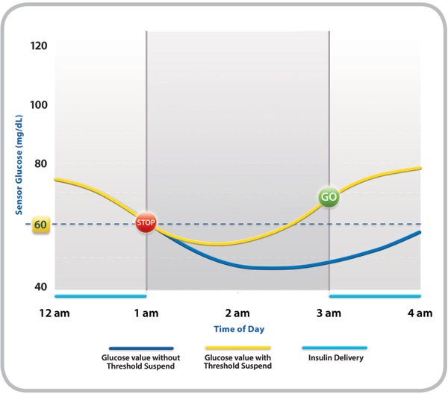
Suspend On Low
Notes:
Newest feature available with Medtronic 530 and forward. Patient can turn off any time. If not answered, suspend for 2 hours.

Slide 10
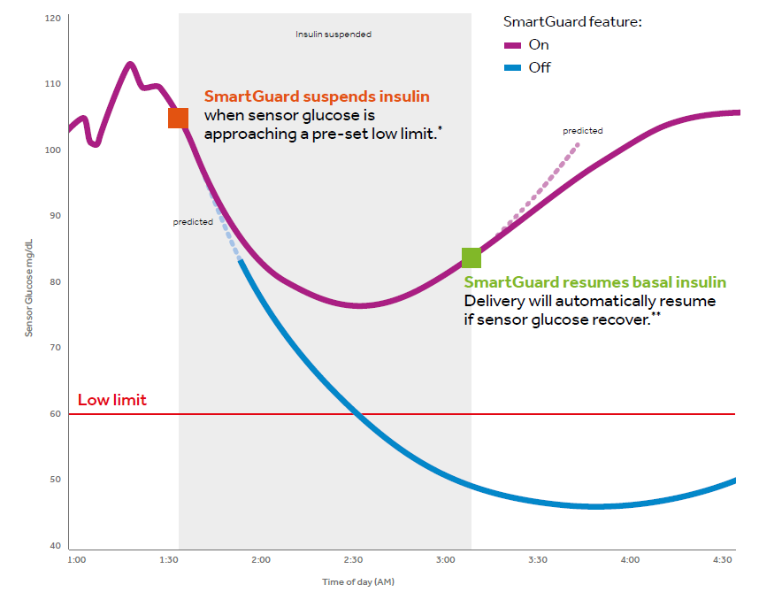
Suspend Before Low
Notes:
Newest feature available only with Medtronic 670. People seem to love this feature!

Slide 11
Auto Mode Delivery – Medtronic Only
Pump delivers insulin based on current SG and trend analysis. No set basal rate and the system reevaluates every 24 hours. A complete reset is every six days. Goal is average BG of 120.
Suspend on low stops all insulin when low blood sugar is reached.
Level set based on pump model. Can be set 50-90 mg/dl
Suspend before low stops insulin delivery 30 minutes before predicted low. Suspend lasts 30 – 120 minutes based on glucose trend. Available on Medtronic 670G only.
Can be set 50-90 mg/dl
Notes:
Medtronic advises ~8 week adjustment period. Error on original slide- low can be set down to 50. To reach this goal, time in target is 70-180

Slide 12
The need for more time in TARGET glucose range Avoiding highs and lows can have significant impact
MORE THAN HALF
of people with Diabetes report being “very worried about the risk of hypoglycemic events.”¹
TIME-IN-RANGE
has the biggest impact on daily life. It is a shared and unmet need.²
Time in target
glucose range
1 Nicolucci, A, Kovacs Burns, K. et al. Diabetic Medicine. 30, 767–777 (2013). Research: Educational and Psychological Issues Diabetes Attitudes, Wishes and Needs second study.
2 diaTribe. FDA Workshop: “Outcomes Measures for New Diabetes Therapies Beyond A1c.” Presented at FDA. Silver Spring, MD, August 29, 2016
Notes:
Talking points:
Lead with Insights
“More than 5 out of 10 (about 56%) of people with Diabetes report being “very worried about the risk of hypoglycemic events.”²
This fear and worry is addressed by our MiniMed systems that are available TODAY – our MiniMed 630G and MiniMed 530G systems which reduce the frequency of lows and instill confidence for those fearing lows.
But diabetes experts have identified that there are additional clinical metrics that matter – in addition to prevention/reduction of low blood sugars – and that’s time in range.
Time in range defines the daily experience of living with diabetes and is a battle between extremes.
“… time-in-range (normal blood sugar control) has the biggest impact on patients' daily lives… that current therapies are falling short on time-in-range… and improved time-in-range positively impacts quality of life.”
And now there’s a therapy to help address this clinical and emotional need.

Slide 13
Four days in Auto Mode

Slide 14
Insulin Delivery Options

Slide 15
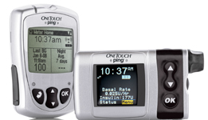
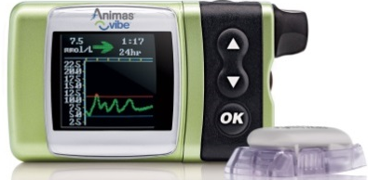
Animas OneTouch ®Ping or ® Vibe
Two Pump Options
Basal Increment – 0.025 units/hour
Reservoir Size – 200 units / Waterproof – 12ft for 24 hours
Ping: Pump & Meter
Vibe: Pump & Dexcom
Linked One Touch Meter
Remote Bolus from Meter
DexcomG4 Capable
No Linked Meter

Slide 16
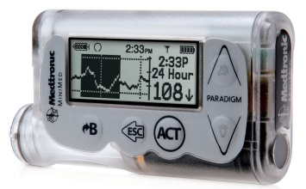
Medtronic MiniMed® 530G, 630G or 670G
Linked Meter: Bayer Contour® Next Link
CGM Capable with Suspend on Low Feature
Basal Increments – 0.025 units/hour
Meter
530G Pump
630G or 670G Pump
Reservoir Size – 180 or 300 units
Watertight – 3ft, 30 minutes
Smartphone Connectivity: iphone w fob
Reservoir Size – 300 units
Waterproof– 12ft / 24 hours
670G Hybrid Closed Loop
Notes:
Remote access for family is limited to 530 only. This has been a concern for sensor users.

Slide 17
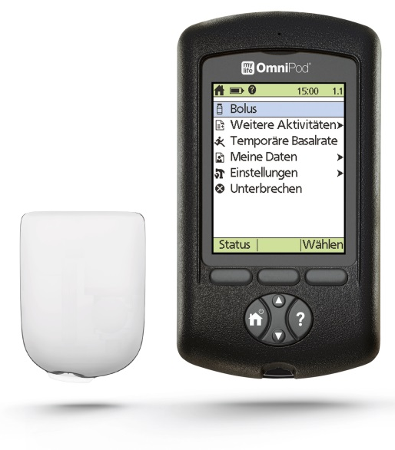
OmniPod®
Meter / Pump Controls
Linked Meter: Freestyle®
Free access to Glooko App
Cannula inserts without seeing it
Tubeless
Must replace after 3 days
Basal Increments – 0.05 units/hour
Reservoir Size – 85 - 200 units
Waterproof Pod – 25ft for 60 minutes
Pod
Notes:
Patients report feeling freer without the cord. Needs a minimum amount of insulin to initiate so waste potential for small amounts.

Slide 18
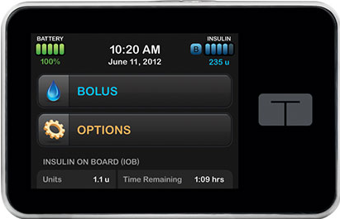
Tandem®
Rechargeable Battery / Touch Screen
Basal Increments – 0.001 units/hour
Watertight – 3ft for 30 minutes
t:Slim X2
t:Flex
Reservoir Size: 85-300u
Dexcom G5 CGM Integration
Bluetooth enabled – remote software uploads
Reservoir Size: 85-480u
Largest Reservoir / No CGM
Notes:
Cannot let pump die! CGM integration approved not yet implemented.

Slide 19
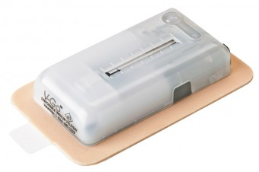
V-Go ® 20, 30 or 40
Disposable
Waterproof 3 feet, 3 inches up to 24 hours
No programming
Does not alarm for empty reservoir
No history / memory

Slide 20
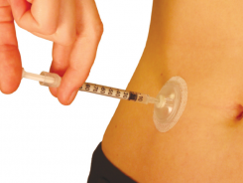
I-Port
Change every three days
Short and long acting insulin should be dosed one hour apart with rapid first
Needles need to be 5-8mm (3/16-5/16”) in length and 32-28 gauge.
Cost $60 / month

Slide 21
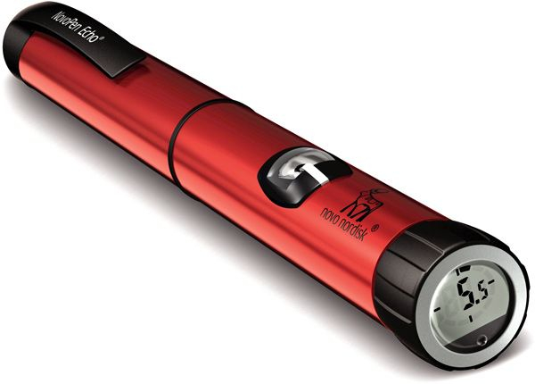
Novo Pen Echo
Memory of last dose (time and amount)
Reusable pen
Available in ½ unit increments

Slide 22
Continuous Glucose Monitor (GGM)

Slide 23
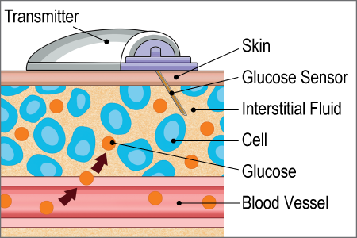
CGM Basics
Continuous sensor glucose readings
Every five minutes = 288 readings a day
Speed and direction of blood sugar
Optional Alert Features
High or low blood sugar
Rising or dropping fast
Shut off insulin (Medtronic only)

Slide 24
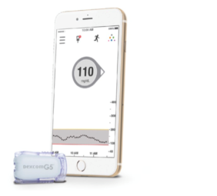
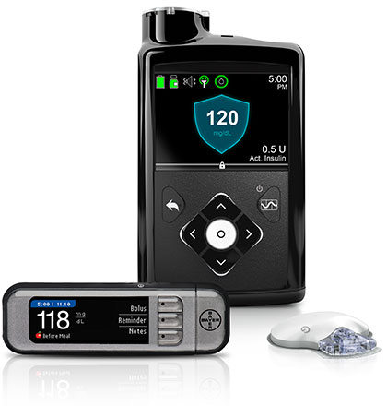
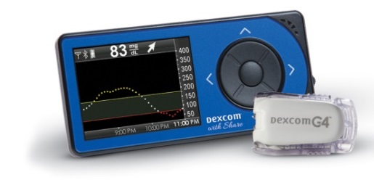
CGM Supplies
Sensor - placed under the skin
Transmitter - sends glucose reading to receiver
Receiver - displays data

Slide 25
Advantages of CGM Therapy
Alerts for out of range glucoses and fast moving glucoses
Some sensors use an app to send alert to multiple people.
Detects hypoglycemia unawareness
Decrease erratic blood sugars
Pattern management
Software to see 7+ days at one time
Notes:
Accuracy and comfort keep improving

Slide 26
Disadvantages of CGM Therapy
Being attached, especially if wearing insulin pump
Feeling overwhelmed
Skin sensitivities
Cost
Does not fully replace blood sugar monitoring
Is not perfect
Notes:
People stop checking BG. Concern with limited calibrations. People become too trusting.

Slide 27
Continuous Glucose Monitor Options

Slide 28
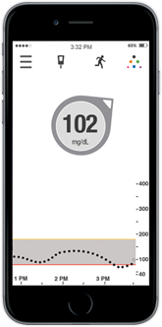
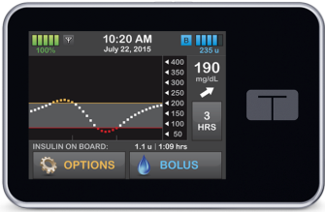
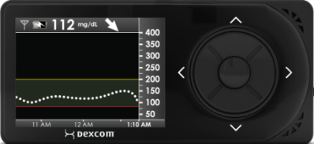
DexcomTM
Sensor Life: 7 days
Displays Glucose Readings: every 5 minutes
Transmitter Warranty: 6 months (G4) / 3 months (G5)
Phone requires app to receive and 2nd app to share data
Dexcom built in a pump
Dexcom Standalone
Dexcom Mobile
tSlim X2 or Animas Vibe
Can share data to some smartphones
Reads to some
smartphones

Slide 29
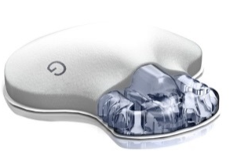
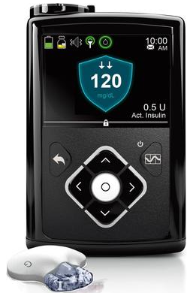
Medtronic
Sensor Life: 6 or 7 days
Displays Glucose Readings: every 5 minutes
Transmitter Warranty: 12 months
530G
630G
670G
Suspend on Low
Suspend on low
Suspends before low

Slide 30
Freestyle Libre Pro
Professional Use Only
Sensor life up to 14 days
No calibration finger sticks required
Waterproof up to 3 feet for 30 minutes
Data recorded every 15 minutes
Reader device activates and scans data
Pending FDA approval for personal use

Slide 31
Sample Reports

Slide 32
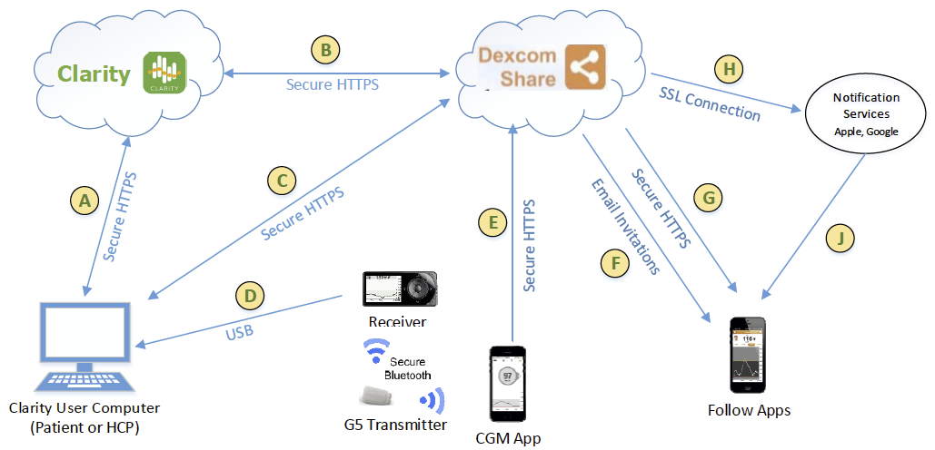
Interface Actions

Slide 33
Diasend

Slide 34
Medtronic
Notes:
More time in range. Time in range is 70-180

Slide 35
Successful Technology Implementation
Right Patient
Right Equipment
Right Time
Right Insurance
Notes:
Patient – must be ready for technology mentally as well as physically
Equipment - what is important to them to live THEIR life with diabetes
Time – can they devote the time to the equipment and make changes
Insurance- sad but true deciding factor.

Slide 36
Traits of successful technology patients
Checks blood glucose 3-6 times a day
Doses insulin before meals
Weighs, measures and counts carbohydrates
Takes only amount of insulin recommended
Uses temp basal with activity changes
Rotates insulin infusion sites every three days
Able to upload device for analysis

Slide 37
Insurance Coverage*
Type 1 Diabetes
Type 2 Diabetes
Insurance | Pump | CGM
Private | Usually | Usually
Medicare | Yes | Dexcom Only
Medicaid | Yes | No
Caresource | Yes | Yes
Insurance | Pump | CGM
Private | Usually | Usually
Medicare | No | No
Medicaid | No | No
Caresource | No | No
*Individual coverage can vary

Slide 38
Future Technology

Slide 39
in-Pen (Companion Medical)
Bluetooth to iPhone (Android coming)
Lispro or Aspart cartridges
Smartphone app
Records insulin doses (0.05 to 30 units)
Can build in alarms for dose reminders
Dose Calculator
Temperature Sensor alerts when out of pen out of acceptable range
“freezing” to body temp
FDA approved 2016. Released expected 2017
http://www.healthline.com/diabetesmine/diabetes-tech-spectations-2017

Slide 40
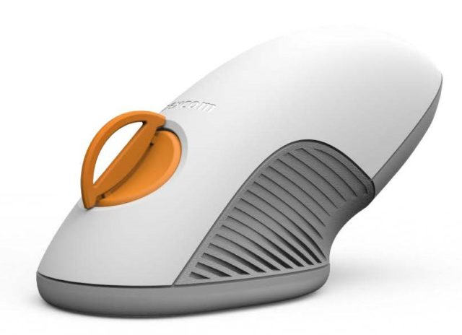
Dexcom
Touchscreen Receiver
One button inserter
G6 transmitter
10 days
Once a day calibration
Acetaminophen restriction lifted
https://www.diabetesdaily.com/blog/a-look-at-dexcoms-upcoming-6th-7th-generation-cgm-tech-284530/

Slide 41
Tandem
www.tandemdiabetes.com

Slide 42
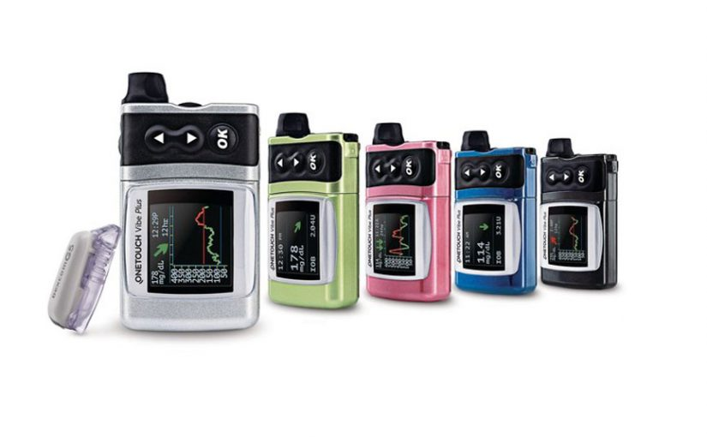
Animas Vibe Plus
Vibe with G5 DexCom integration
http://insulinnation.com/treatment/fda-approves-animas-onetouch-vibe-plus/
Notes:
No launch date set

Slide 43
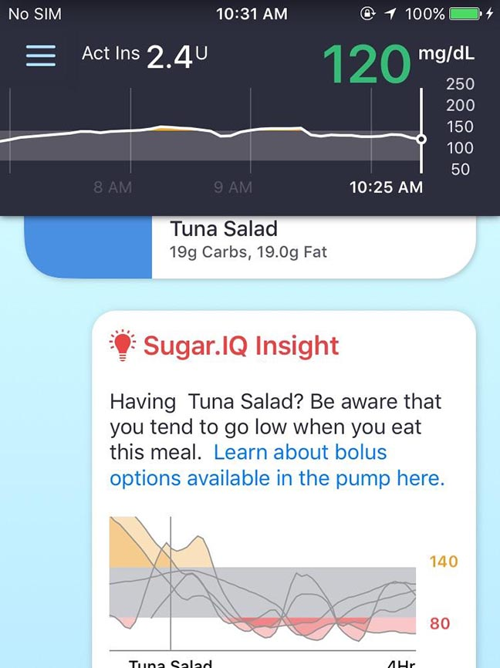
Medtronic Stand Alone CGM
Partner with IBM Watson
Reads straight to smartphone
Uses Sugar IQ App
http://www.healthline.com/diabetesmine/diabetes-tech-spectations-2017#3

Slide 44
Omnipod
http://www.healthline.com/diabetesmine/diabetes-tech-spectations-2017#8

Slide 45
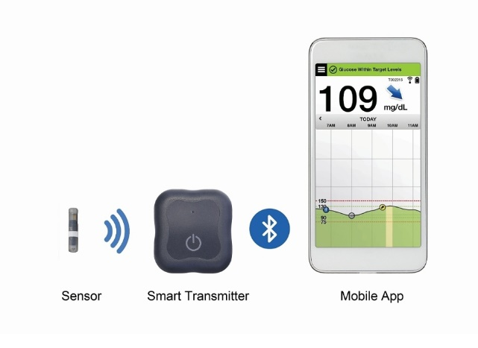
Eversense
Not approved in the US
Sensor placed under the skin by doctor
Lasts up to 90 days
Transmitter is waterproof and rechargeable
Transmitter vibrates on the skin
Reads to smart phone
https://eversensediabetes.com

Slide 46
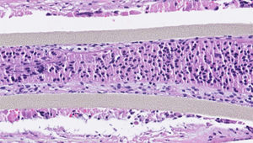
Viacyte
Stem Cell-Derived Islet Replacement Therapies
Human embryonic stem cells
http://viacyte.com

Slide 47
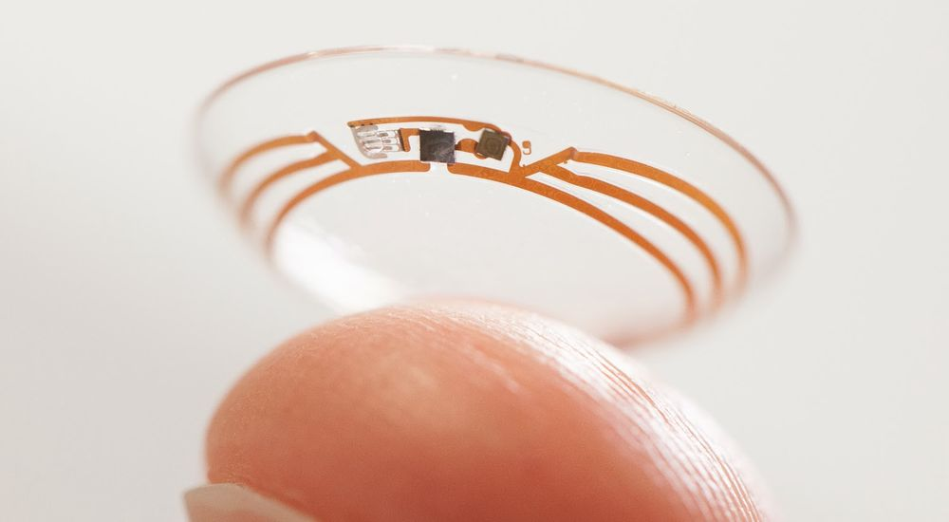
Google Smart Contact
http://www.diabeticconnect.com/diabetes-slideshows/420-the-future-of-diabetes-technology

Slide 48
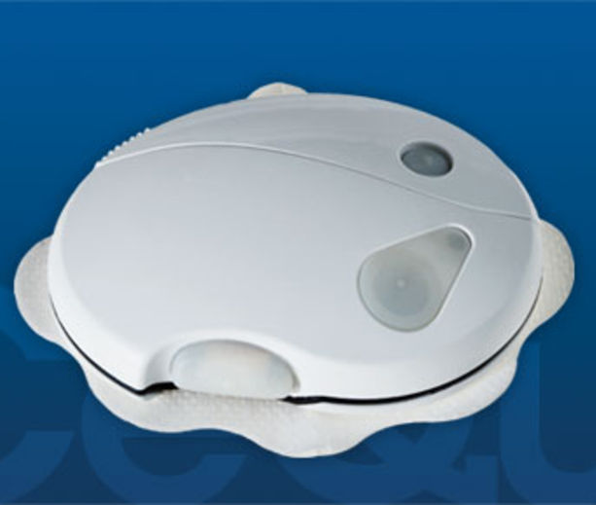
CeQur's PaQ pump (available in Europe)
http://www.diabeticconnect.com/diabetes-slideshows/420-the-future-of-diabetes-technology

Slide 49
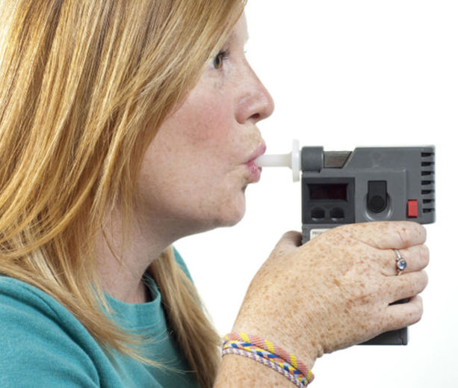
Blood Glucose-Reading Breathalyzer
http://www.diabeticconnect.com/diabetes-slideshows/420-the-future-of-diabetes-technology

Slide 50
Conclusions
Lots of technology options – don’t make assumptions
Picking the right person and the right technology = success
Future technology is exciting. Never promise what is not approved and available today

Slide 51
Thank you!
Janet.Zappe@osumc.edu

